Slide 1
MD Curriculum: Phase-I Overview
Dr. Maha Z. Al-Riyami
Phase-I coordinator
Assistant Professor, Biochemistry Department

Slide 2
The mission of College of Medicine and Health Sciences, SQU
To produce competent medical doctors and health scientists who are life-long learners, able to pursue further specialization and continuous professional development.
To create a scholarly environment that supports innovation and excellence in teaching, research and postgraduate education.
To deliver, through Sultan Qaboos University Hospital, quality patient-centered care that responds to community needs and major global health problems.
https://www.squ.edu.om/medicine/About-College/Mission-Vision

Slide 3
The vision & core values of College of Medicine and Health Sciences, SQU
Vision:
We aspire to international prominence in medical education, advancement in biomedical sciences and health research.
Core values:
Excellence Quality Service Creativity & Innovation
Respect Integrity Transparency
Team Work Collaboration Flexibility
Accountability Public Trust & Confidence
Student Handbook, 2023-2024, College of Medicine and Health Sciences, SQU

Slide 4
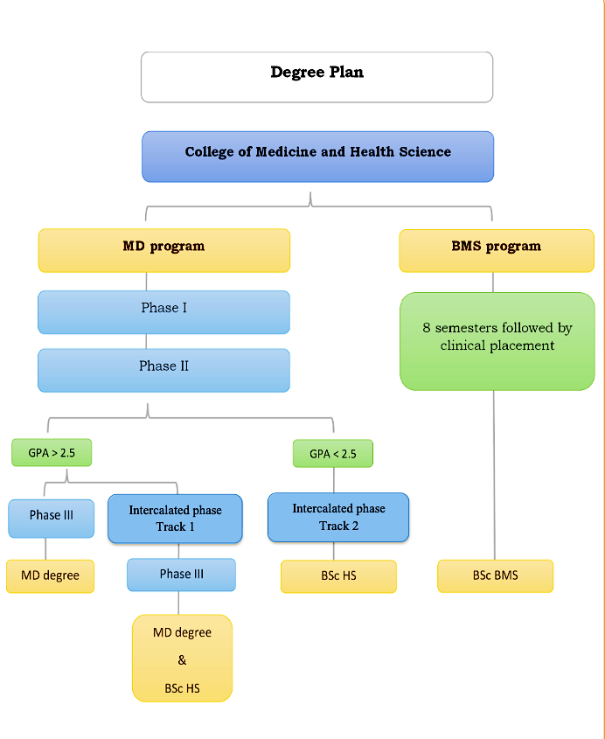
Phase-I duration:
2-3 semesters for direct entry and
after the Foundation Program Courses
Student Handbook, 2023-2024, College of Medicine and Health Sciences, SQU

Slide 5
The aim of Phase-1
Provide the students with a number of complementing courses that are appropriately time-tabled to assess students’ ability to acquire essential and fundamental concepts that will appraise his/her ability to study medicine.
Phase-1 plan;
University Electives [6 Cr],
University Requirements [6 Cr],
Academic English for Medicine [3 Cr],
Medical Informatics [2 Cr].

Slide 6
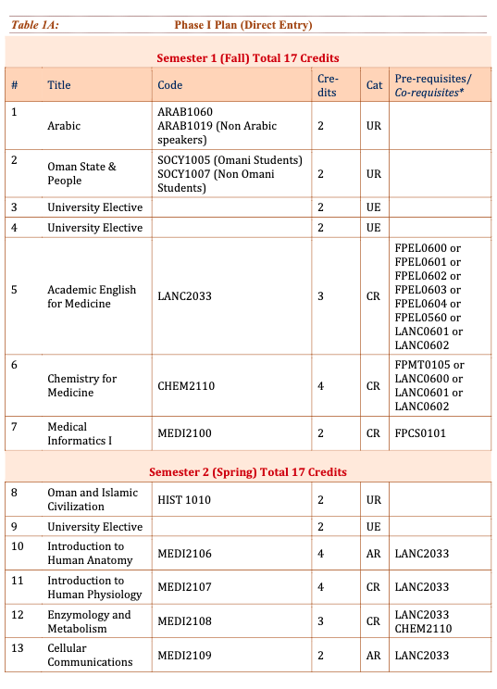
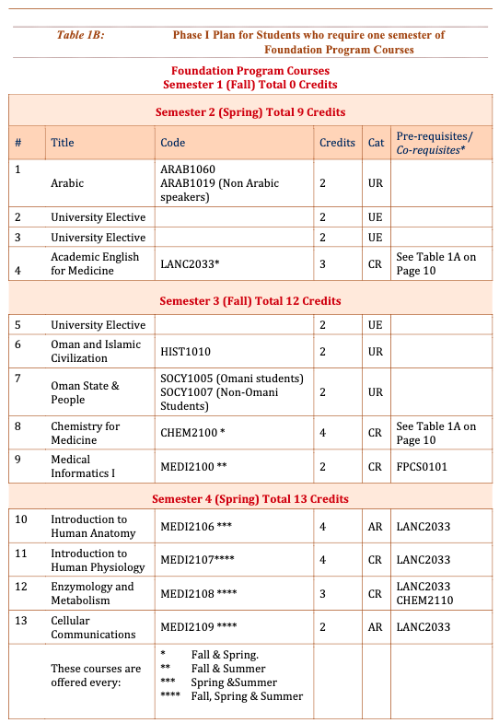
Student Handbook, 2023-2024, College of Medicine and Health Sciences, SQU

Slide 7
Admission & Progression regulations:
Admission to Phase- I of the MD program is subject to Ministry of Higher Education and University Regulations.
Course Load:
A minimum of 9 credits per semester.
Students may register for one course if they are exiting a Phase of the MD program or if their score is “C+” or below in that particular course.

Slide 8
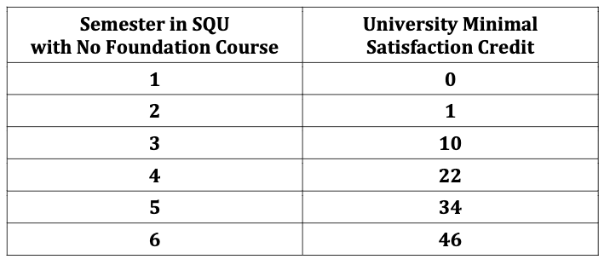
The Minimum Satisfactory Credit rule for Phase I of the MD program as approved by the University Council:
Students who do not achieve the minimum satisfactory credit will be asked to withdraw from the University.
Student must take measures to improve the number of earned credits and be aware that the following does not increase the earned credits:
1. Failing a course
2. Repeating a passed course

Slide 9
Progression Standards to Phase-II:
A focused GPA (fGPA) of 2.50 (currently 20 credits) is the required pass standard at the end of Phase I.
fGPA is calculated based on the following specified core courses:
- Academic English for Medicine - Chemistry for Medicine
- Introduction to Human Physiology - Cell Communication
- Enzymology and Metabolism courses - Introduction to Human Anatomy
Phase I duration is from two to five semesters.
If a student exceeded the max duration of 5 semesters without obtaining an fGPA of at least 2.50 will be withdrawn from the college of Medicine and may transfer to another college if they meet the transfer requirements.

Slide 10
Summer semester regulations
Students who are expected to progress to Phase-II by the end of summer are eligible to study courses in the summer semester.
In the summer semester, students in phase I can take up to 3 courses with maximum of 8 credits provided that:
1. The student is not under probation.
2. The student status after the spring semester is not suspended due to failure in 50% or more in the spring semester.

Slide 11
Summer semester regulations
- Availability of UE and UR courses depends on the offering colleges, and students need to check if they will be available in the summer.
- For courses from the College of Medicine, the following usually offered in summer semesters (subject to change): - Medical Informatics I
- Introduction to Human Anatomy
- Introduction to Human Physiology
- Enzymology and Metabolism
- Cellular Communications

Slide 12
Eligibility criteria for summer registration:
MD Phase-I students can register only if he/she has remaining 8 credits in phase-I or below.
Students on second probation or who have failed 50% of courses in spring are not allowed to register.
Students who have withdrawn or postponed a course or have less load in fall and spring will be given less priority depending on the available slots.
MD Phase-1 maximum credits allowed 8 CR (3 courses).
Students may register only one university requirement or university elective.

Slide 13
Grade Scale:
Each grade carries numeric value for the purpose of computing a weighted average on a 4-point scale.

Slide 14
Available Services for students
Medical library:
A separate building in the College of Medicine where students can borrow medical resources or spend their break time there to study. The library can also be accessed off-campus (online).
Various medical journals, books and resources can be accessed for free through the SQU libraries website (https://squ.edu.om/libraries).
Academic advisor:
Assigned to each student to guide them during the pre-clinical.
To know your academic advisor, sign in to the SQU portal system, then navigate to Personal > Personal Information.

Slide 15
Available Services for students
Support services:
- University Student Counselling Centre.
- Student Clinic.
- Student Well-Being Clinic (SQUH).
Modes of referral to Student Well-Being Clinic
Referrals from FAMCO or the Student Clinic at SQU.
Referrals from the Student Counselling Centre, SQU.
Referrals from Assistant Dean’s Offices of the College of Medicine and Health Sciences.

Slide 16
Student Support & Feedback
Concerns related to Phase-I curriculum in general:
• Phase-I coordinator – Dr. Maha Z. Al-Riyami (mahazr@squ.edu.om)
• Curriculum Committee Chair – Prof. Reem Al Abdwani (rabdwani@squ.edu.om)
Concerns related to Phase-I assessment in general:
• Phase-I coordinator – Dr. Maha Z. Al-Riyami (mahazr@squ.edu.om)
• Examinations Committee Chair – Dr. Maryam Al Shukri (mariamn@squ.edu.om)
• Examinations Committee Deputy Chair – Dr. Halima Al Balushi (halima07@squ.edu.om)
Logistical and other MD program-related issues:
• Asst. Dean for Undergraduate Studies - Dr. Arwa Al Kindi (arwank@squ.edu.om)

Slide 18
Full details regarding the program and the regulations are available in the student handbook.

